Slide 1
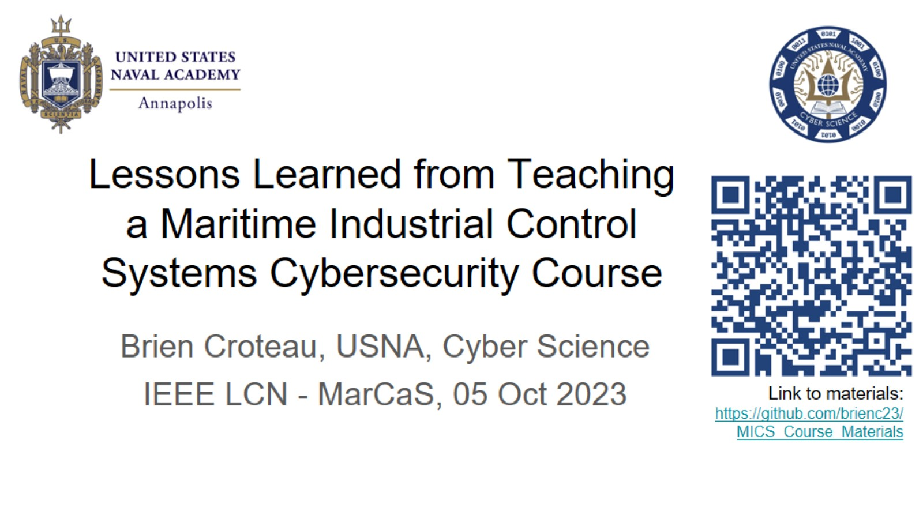
Lessons Learned from Teaching a Maritime Industrial Control Systems Cybersecurity Course

Slide 2
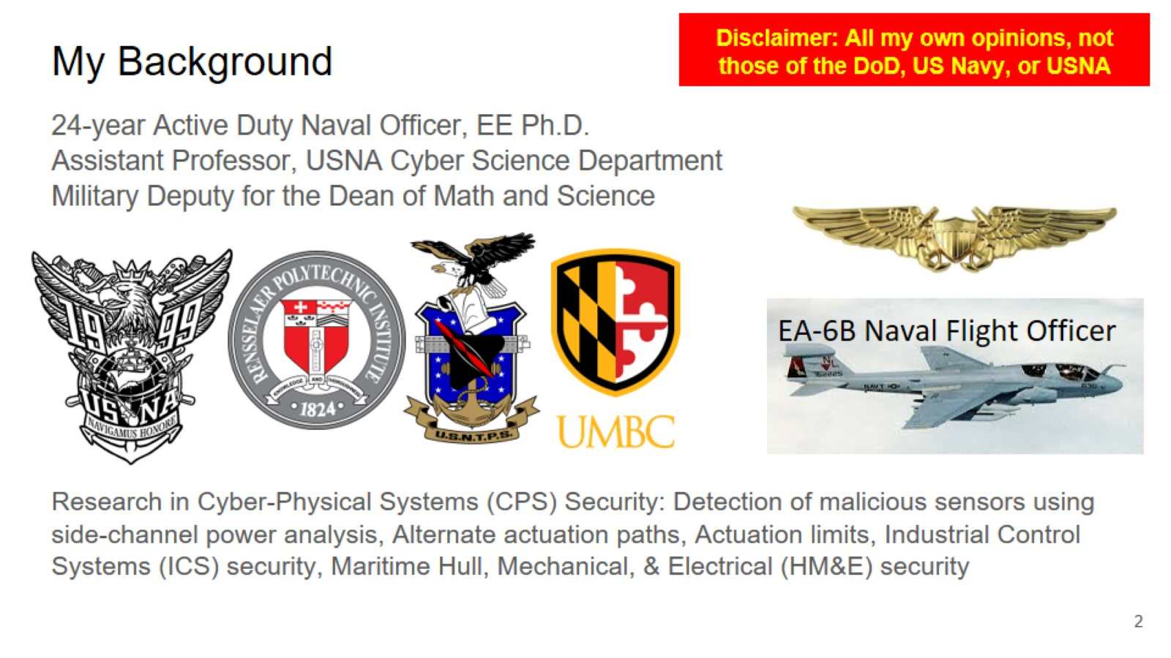
My Background

Slide 3
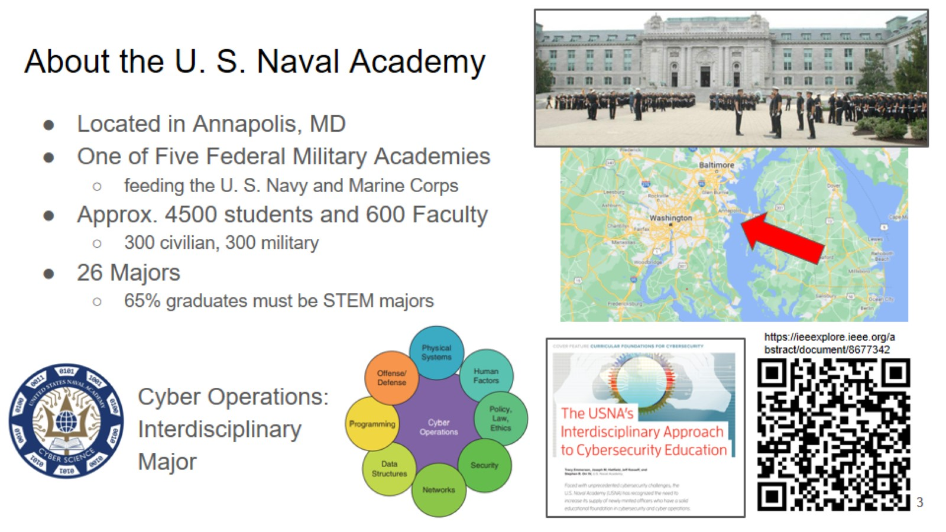
About the U. S. Naval Academy

Slide 4
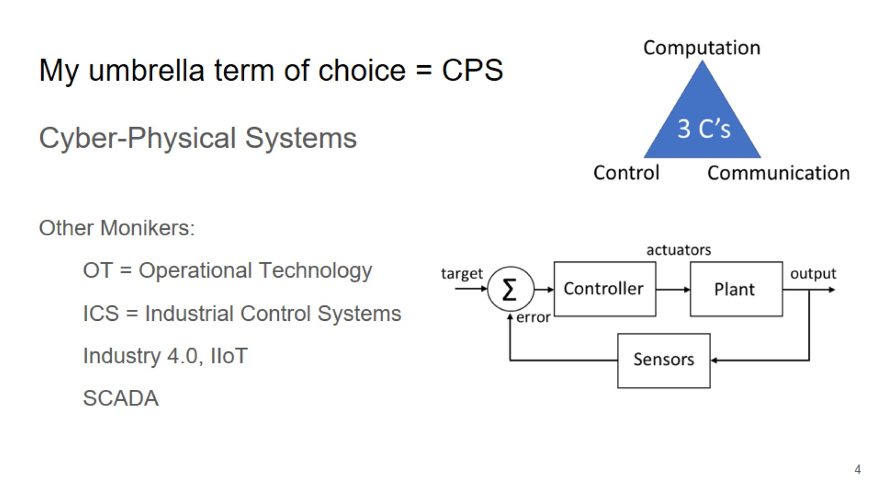
My umbrella term of choice = CPS

Slide 5
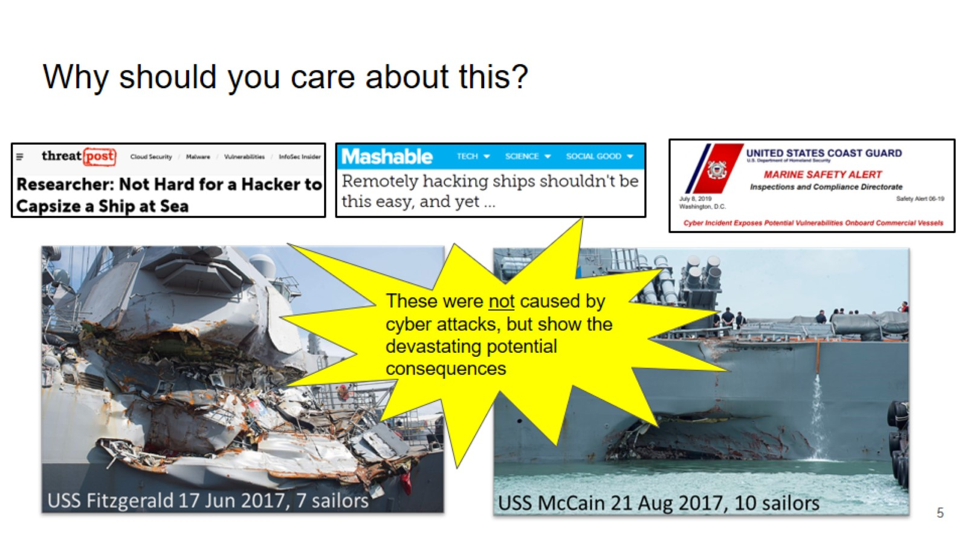
Why should you care about this?

Slide 6
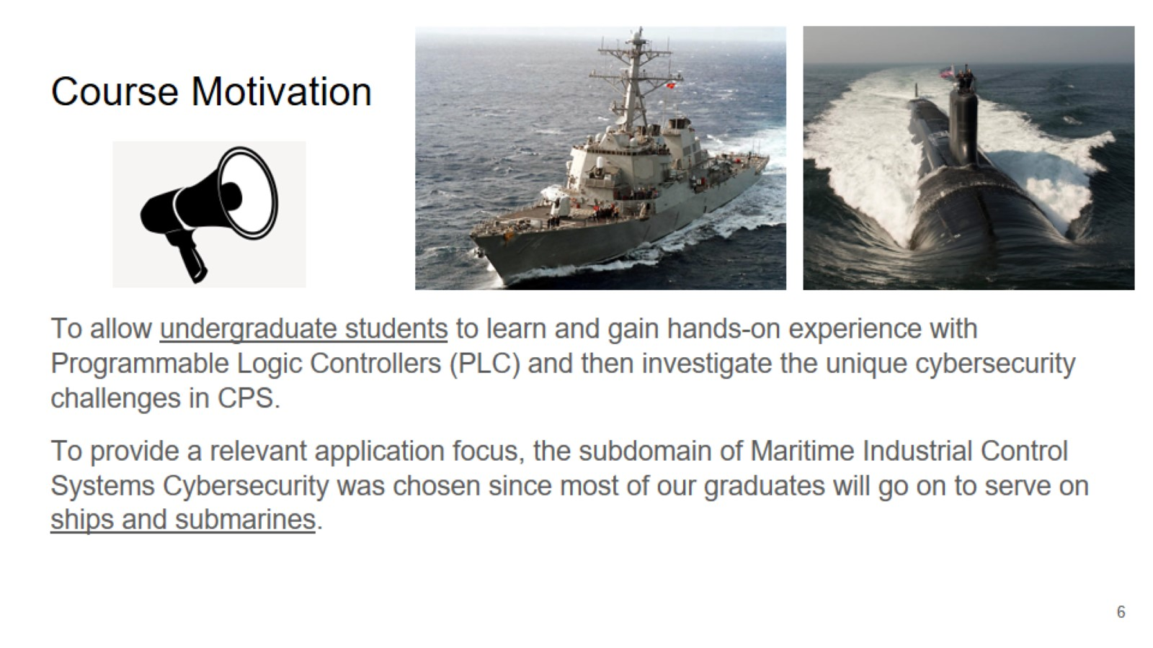
Course Motivation

Slide 7
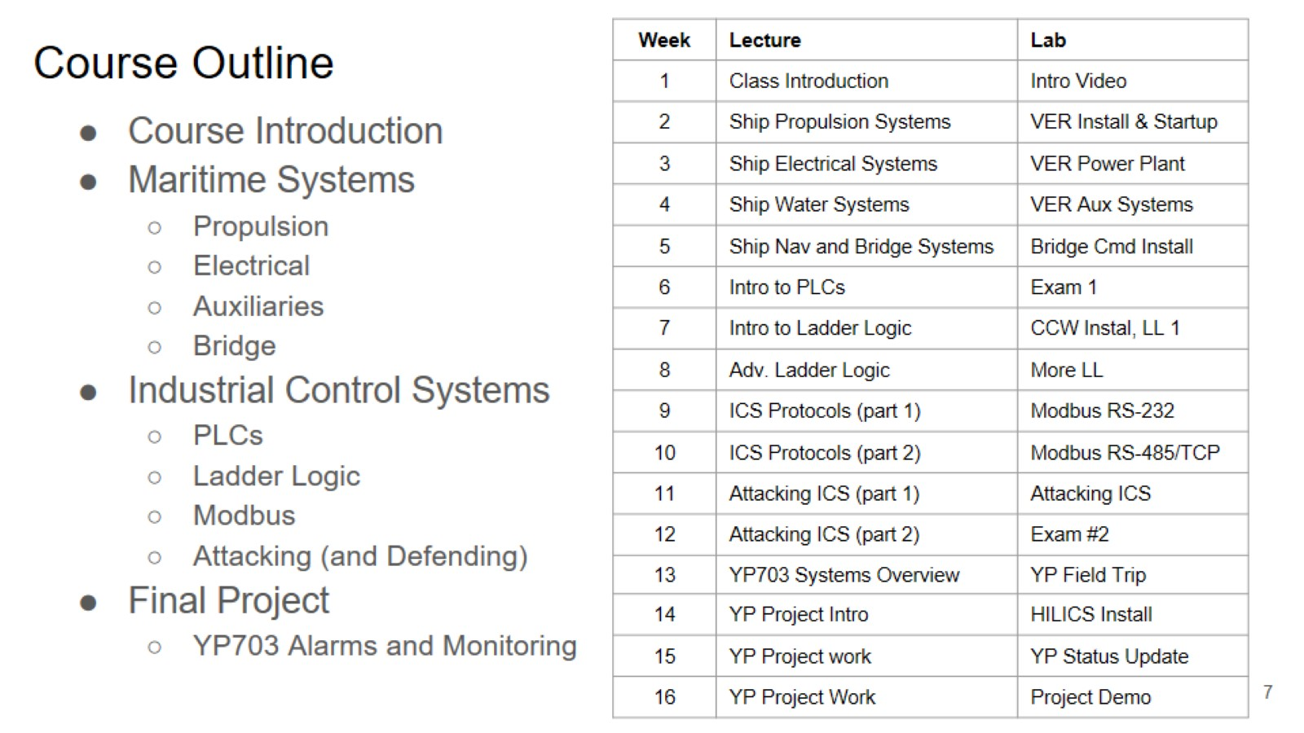
Course Outline

Slide 8
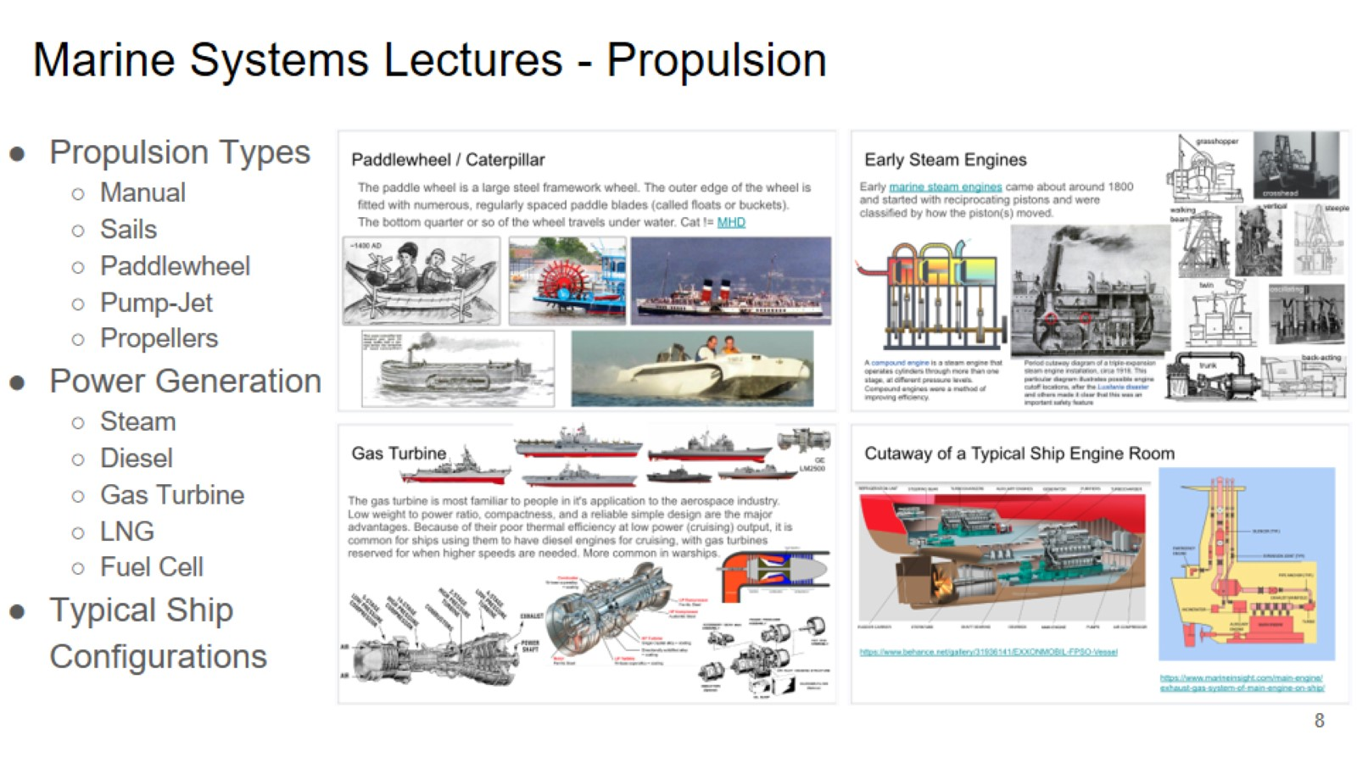
Marine Systems Lectures - Propulsion

Slide 9
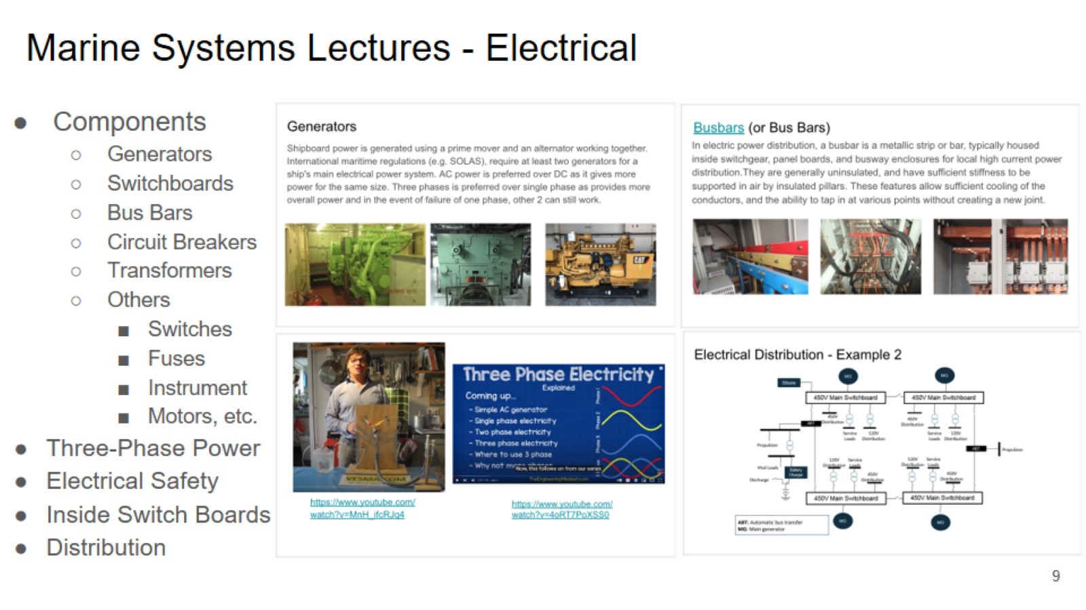
Marine Systems Lectures - Electrical

Slide 10
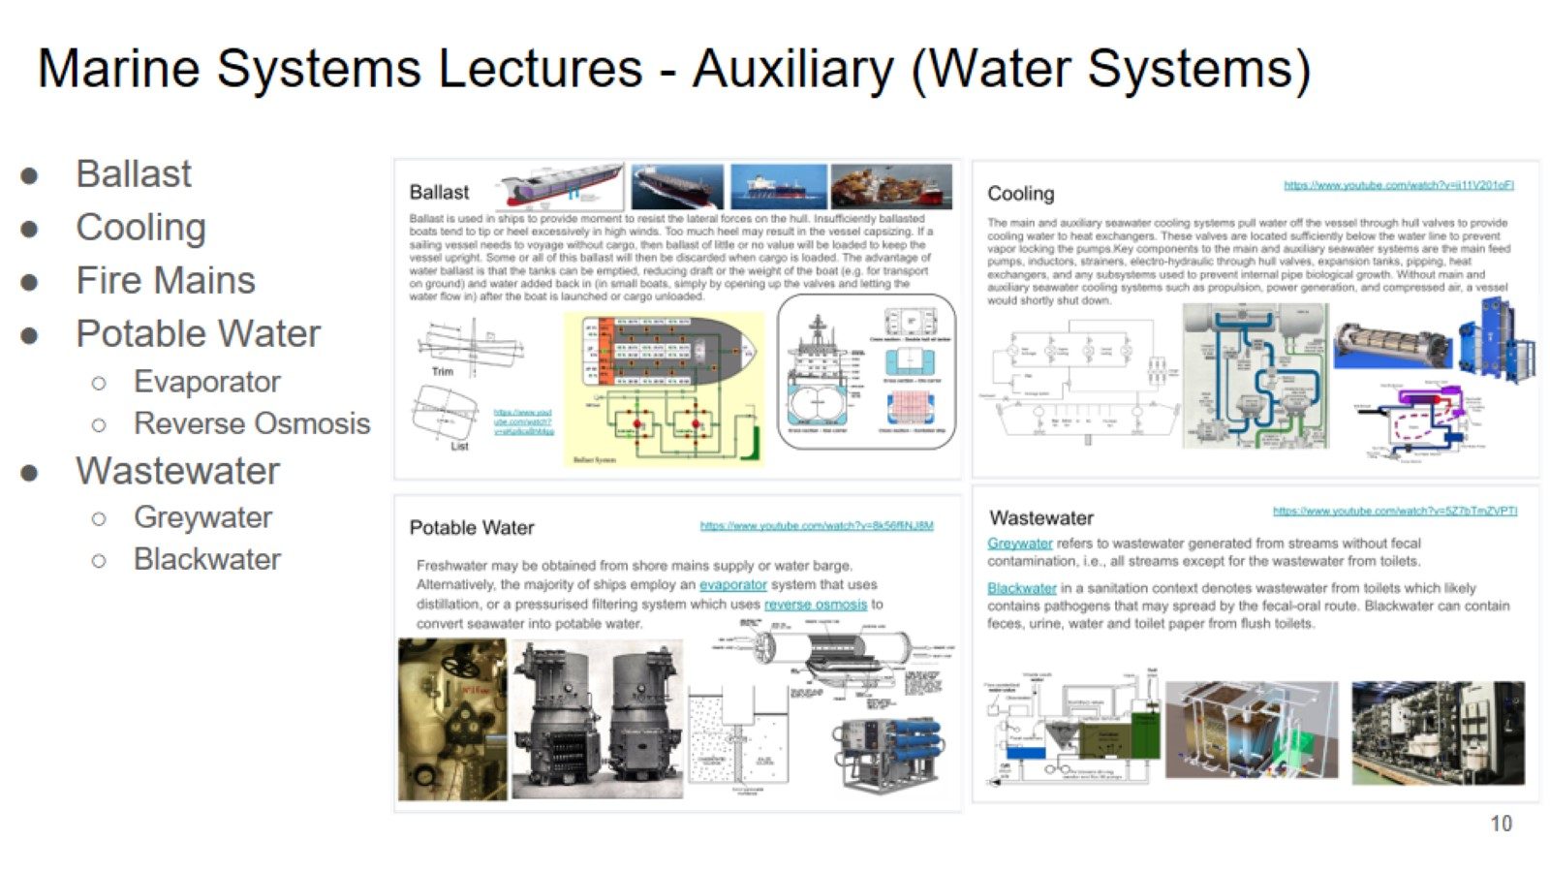
Marine Systems Lectures - Auxiliary (Water Systems)

Slide 11
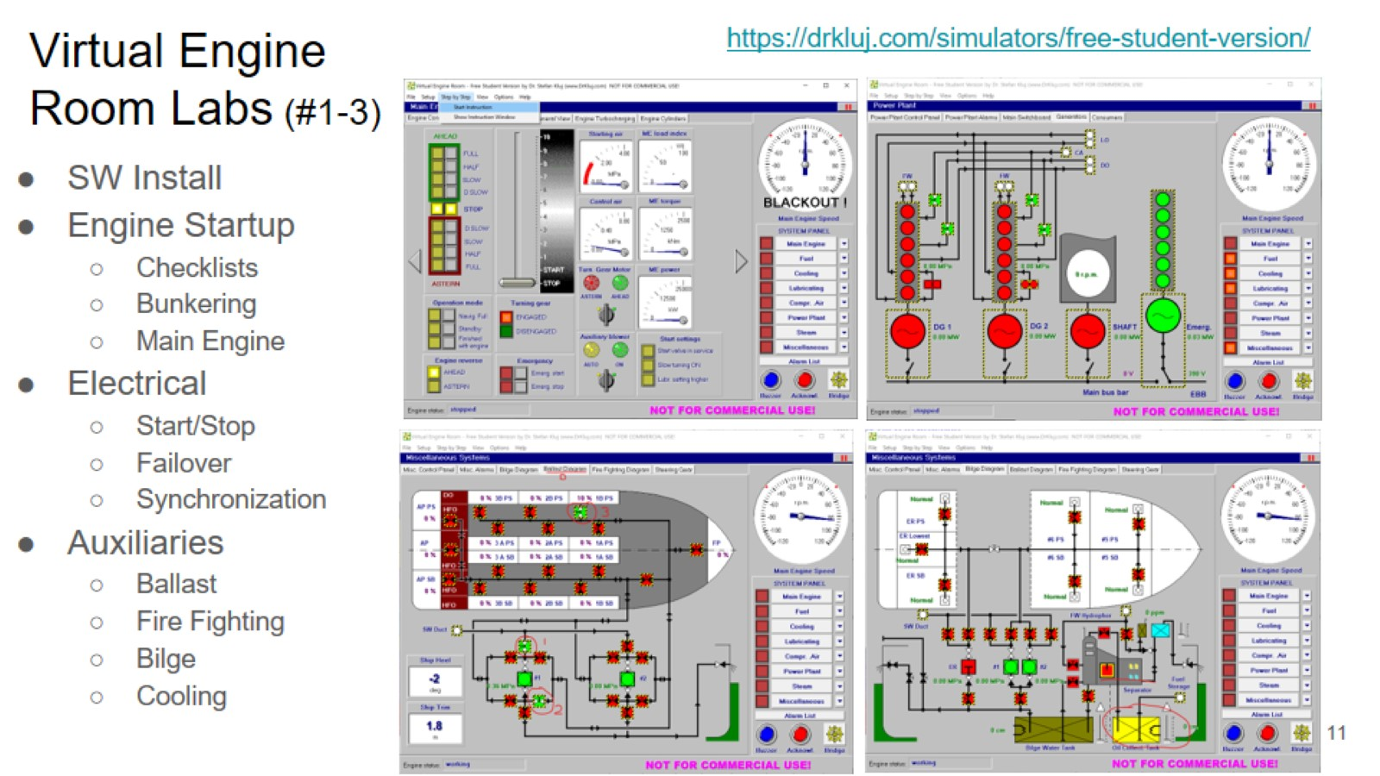
Virtual Engine Room Labs (#1-3)

Slide 12
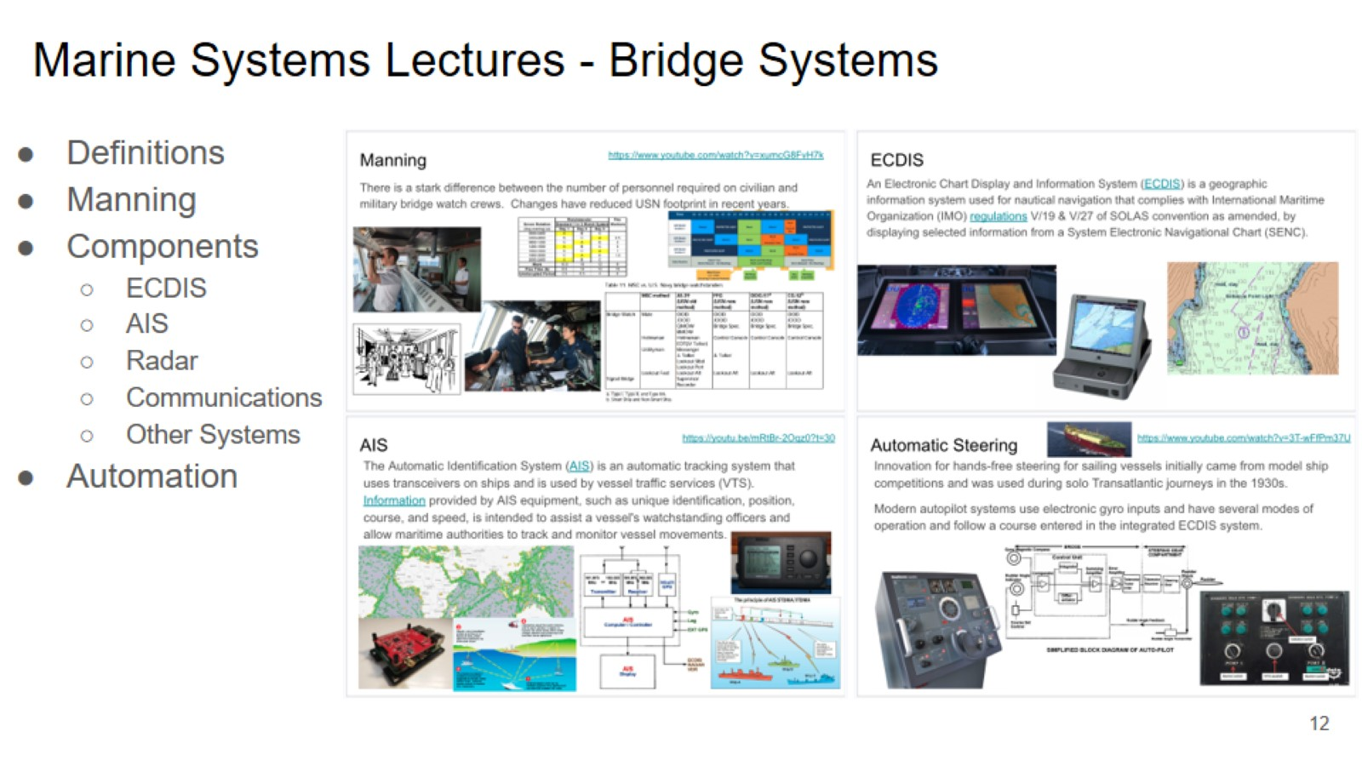
Marine Systems Lectures - Bridge Systems

Slide 13
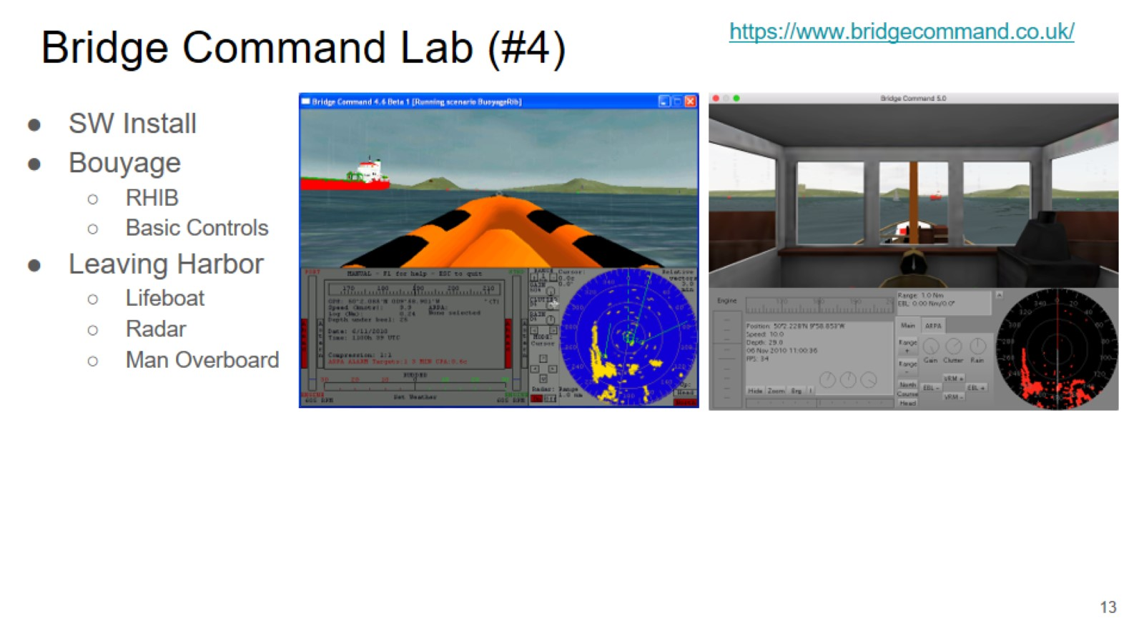
Bridge Command Lab (#4)

Slide 14
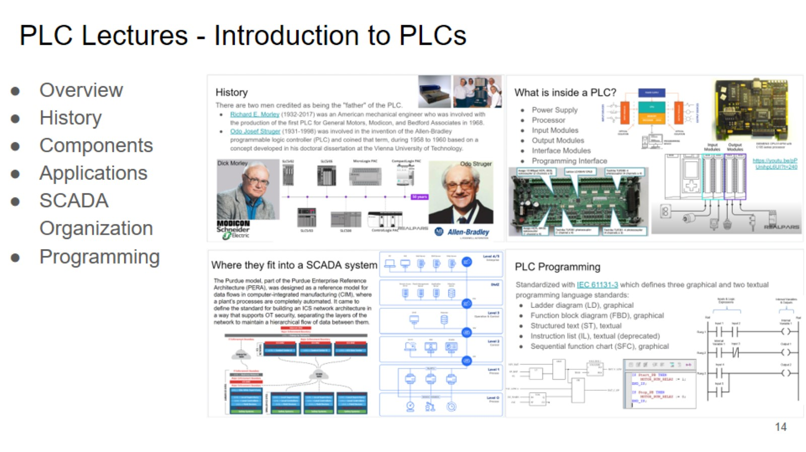
PLC Lectures - Introduction to PLCs

Slide 15
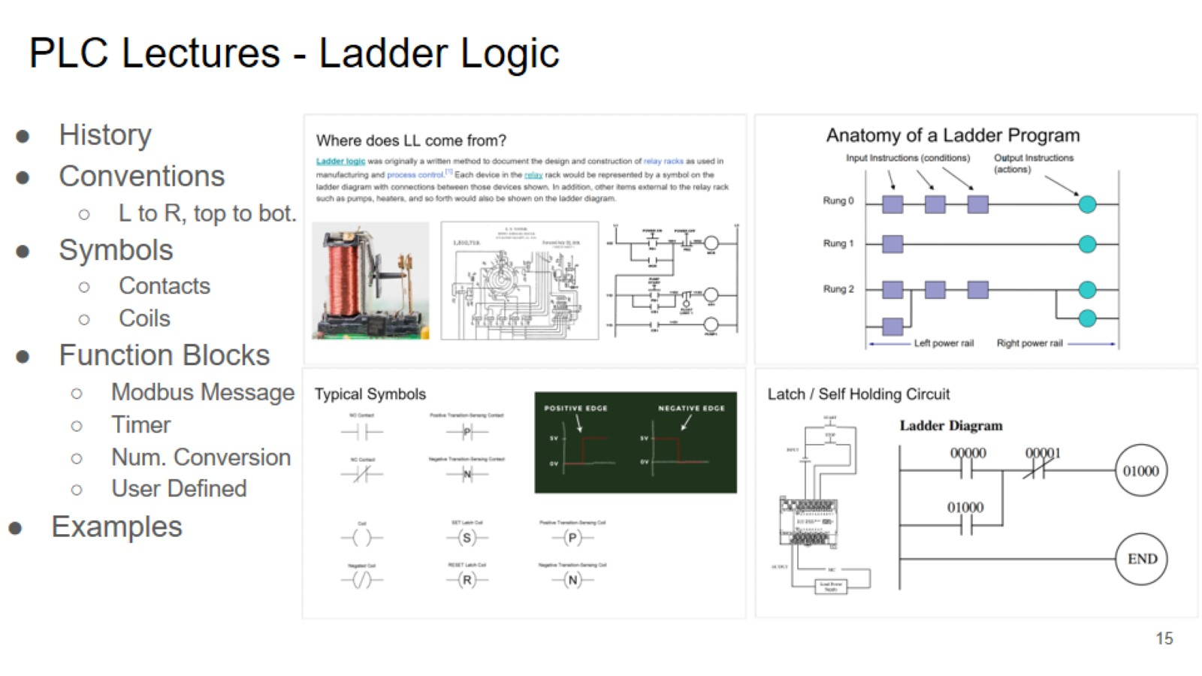
PLC Lectures - Ladder Logic

Slide 16
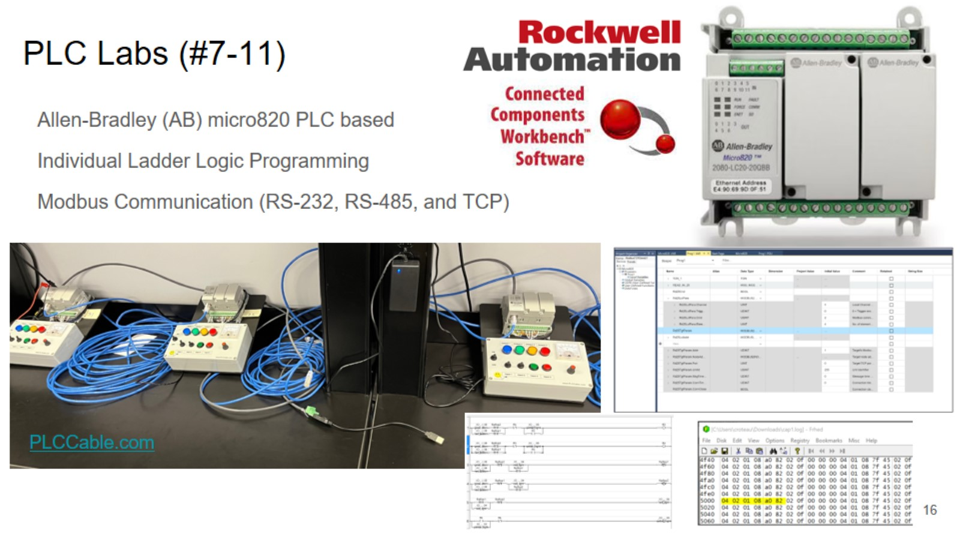
PLC Labs (#7-11)

Slide 17
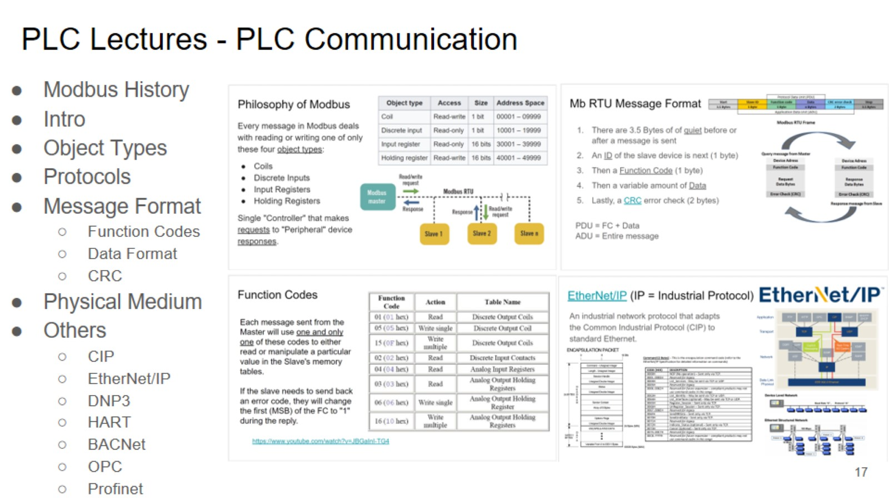
PLC Lectures - PLC Communication

Slide 18
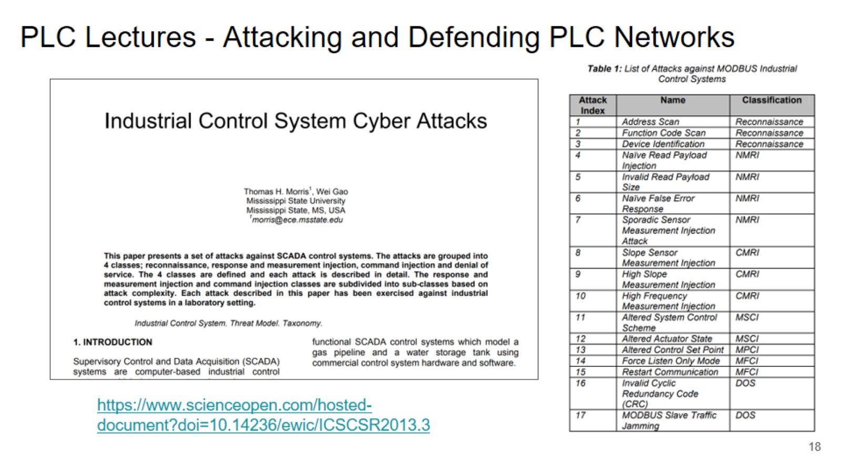
PLC Lectures - Attacking and Defending PLC Networks

Slide 19
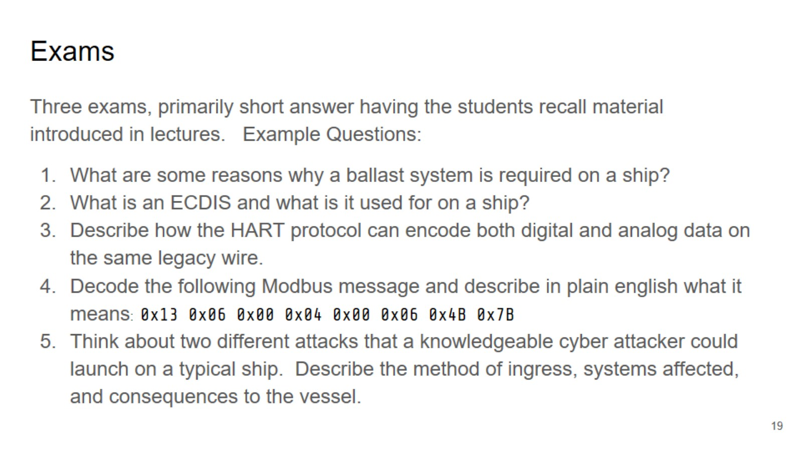
Exams

Slide 20
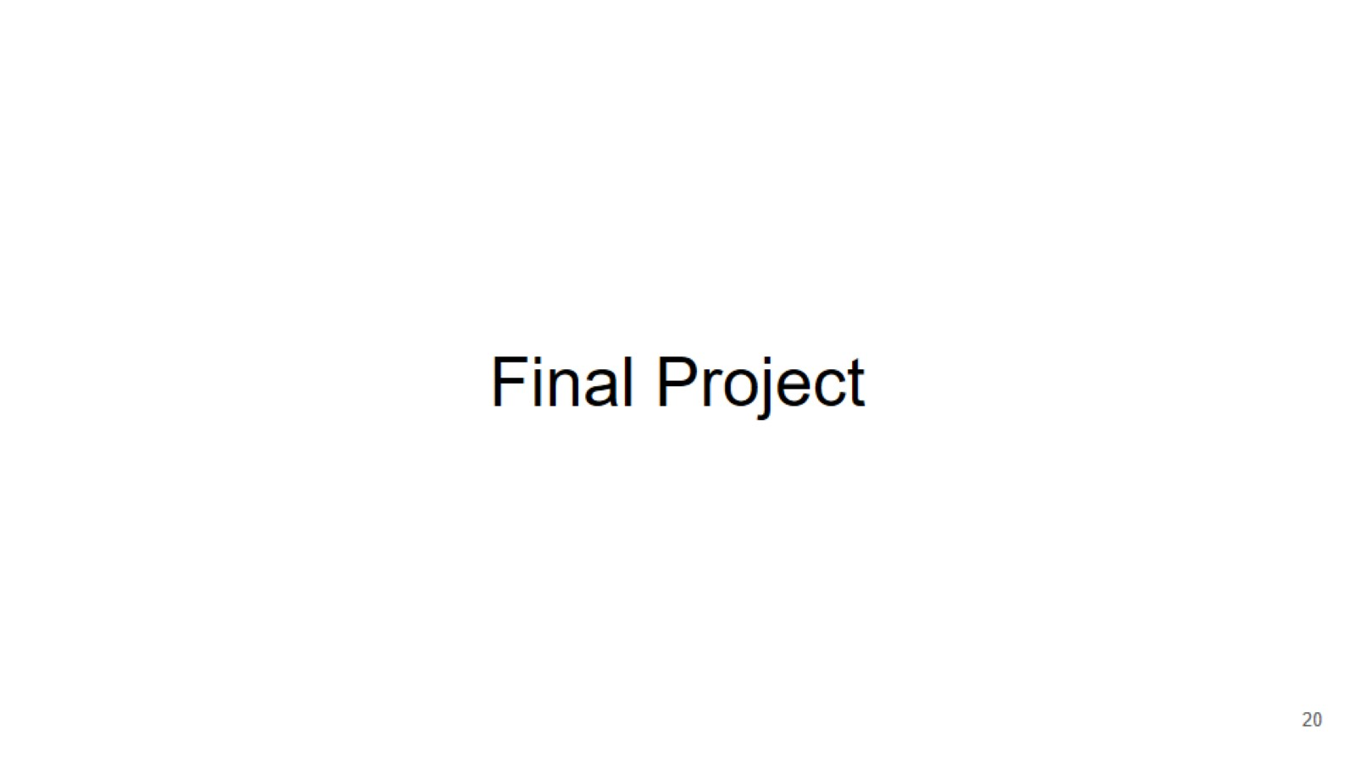
Final Project

Slide 21
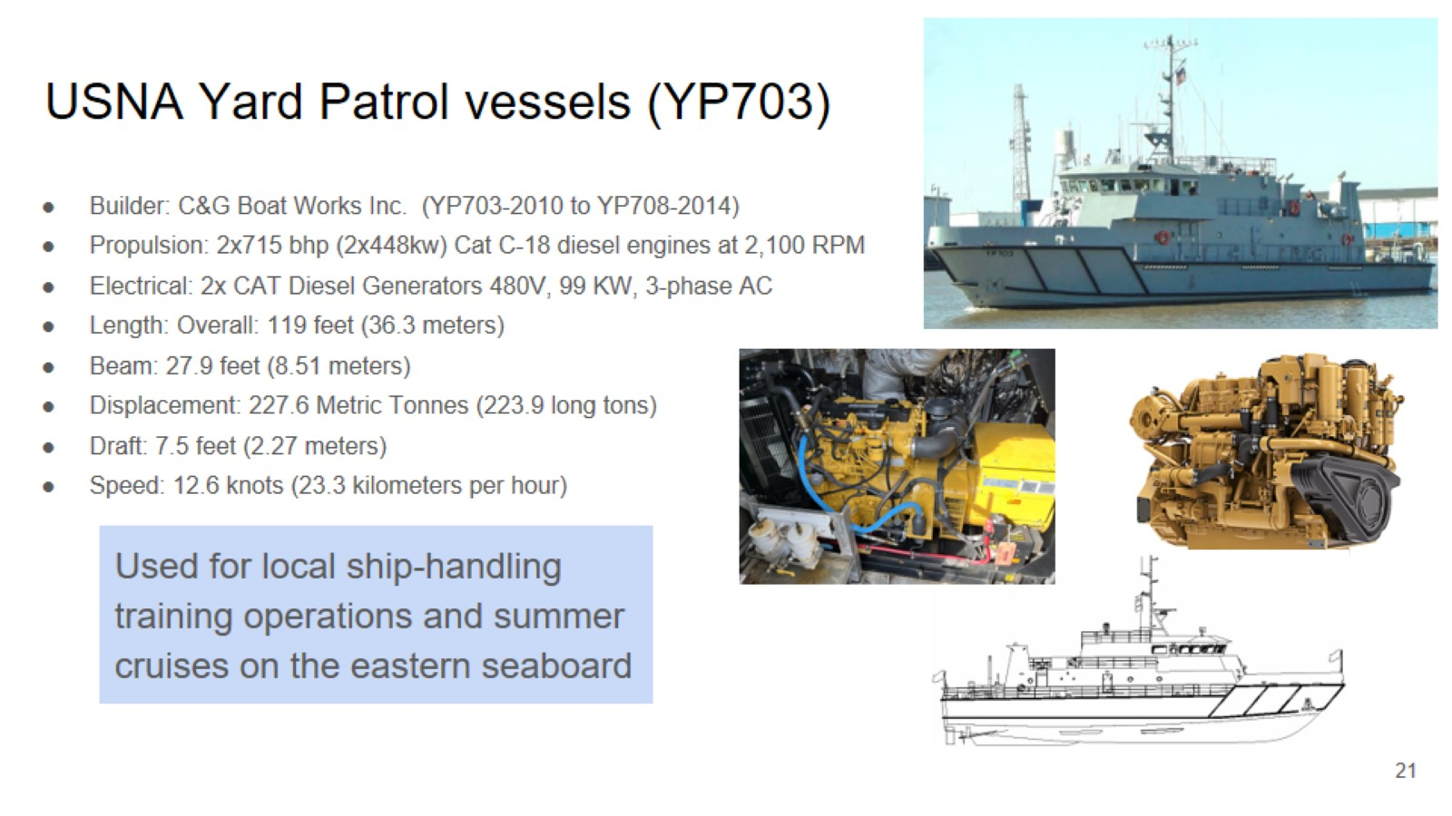
USNA Yard Patrol vessels (YP703)

Slide 22
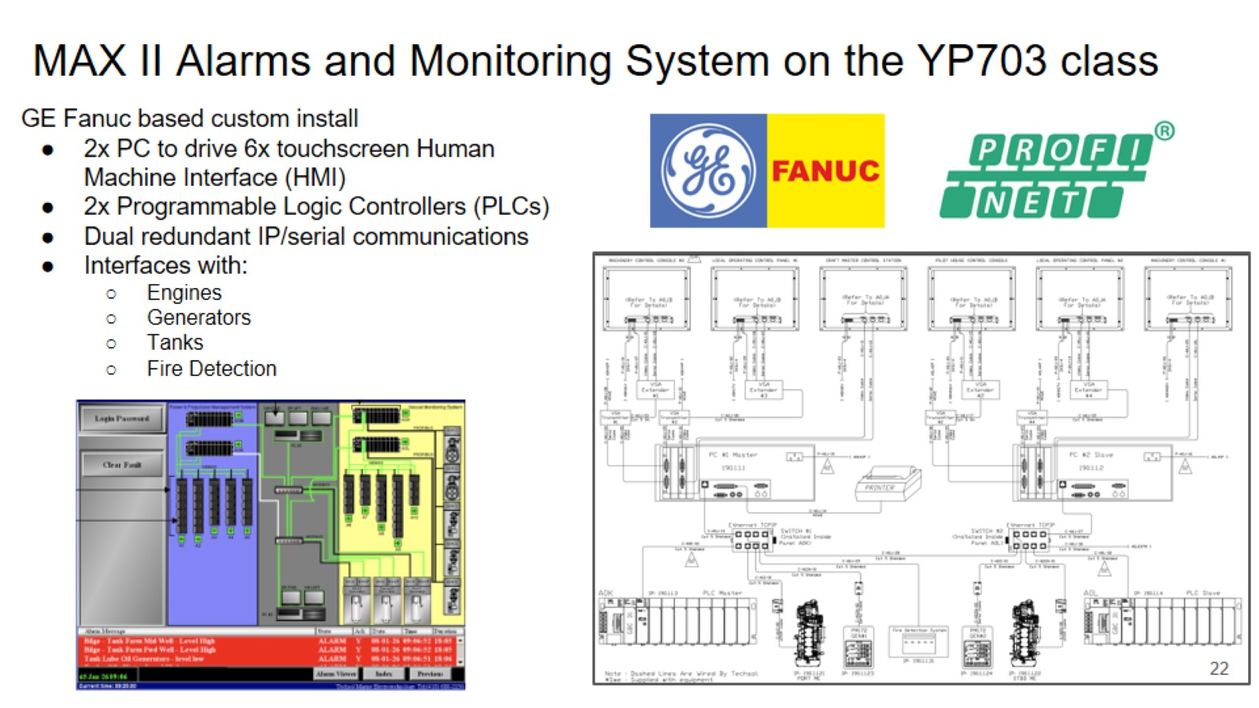
MAX II Alarms and Monitoring System on the YP703 class

Slide 23
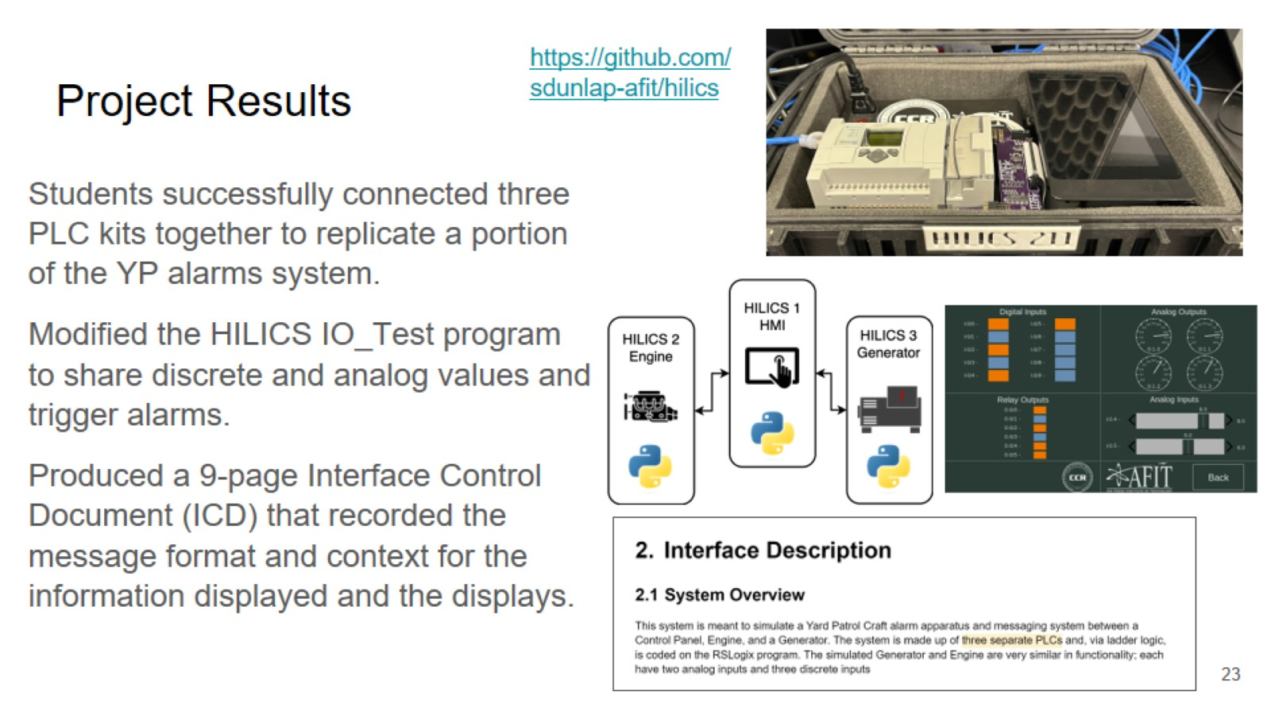
Project Results

Slide 24
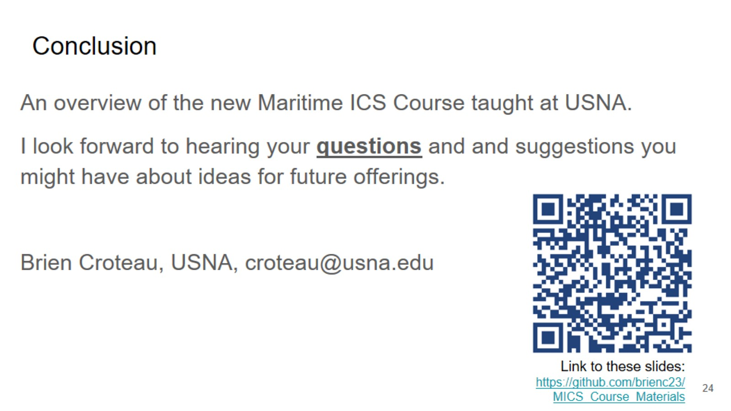
Conclusion

Slide 25
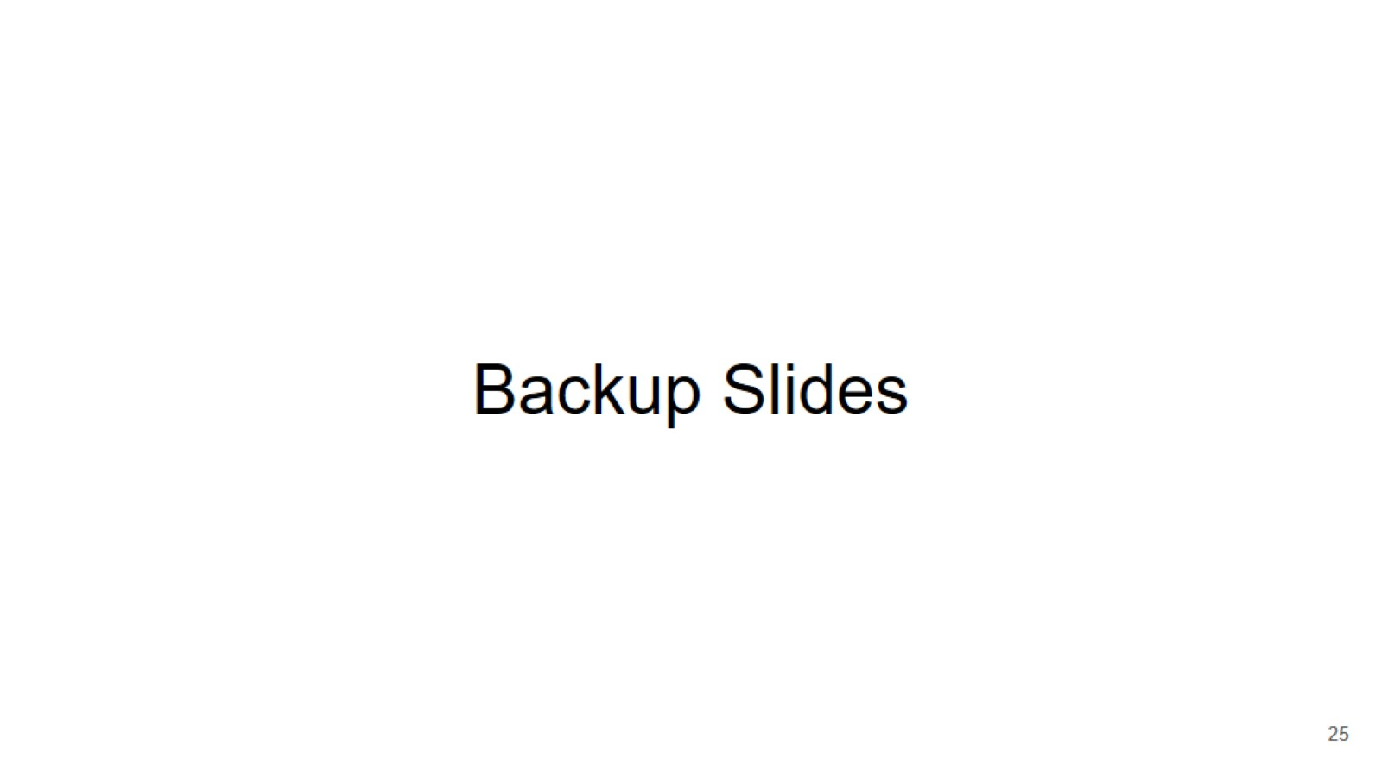
Backup Slides

Slide 26
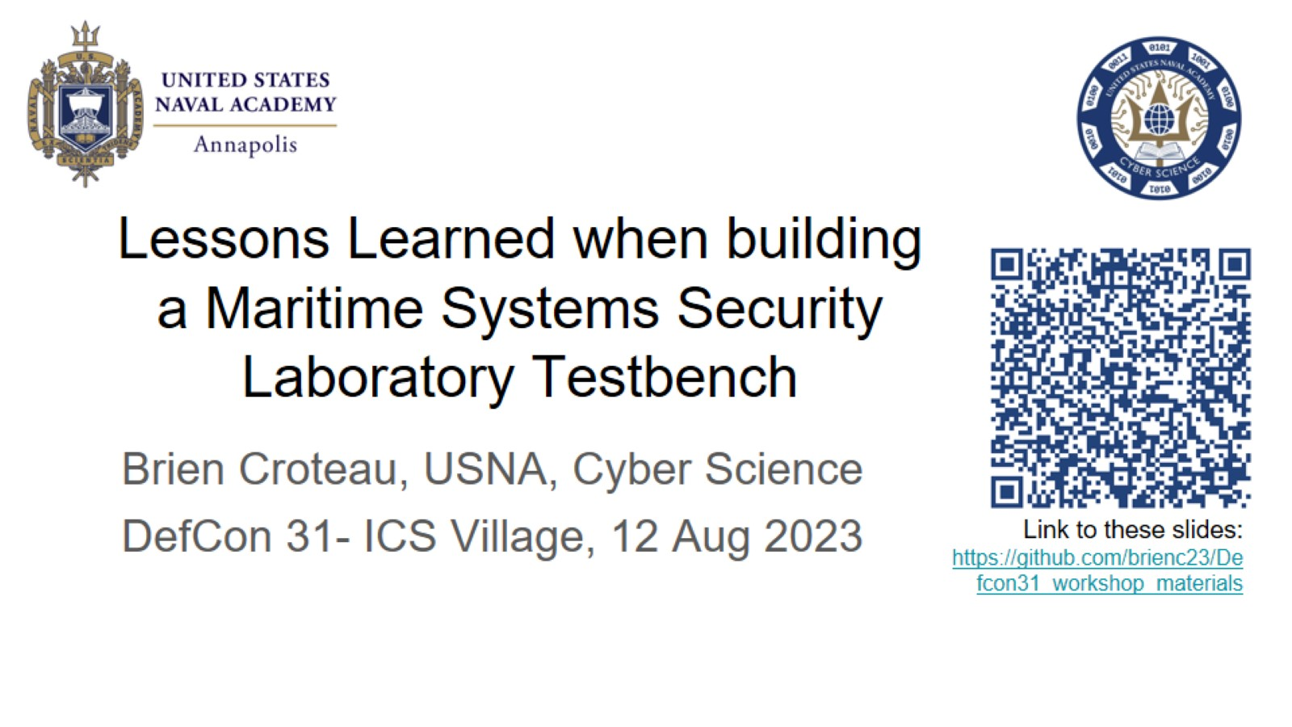
Lessons Learned when building a Maritime Systems Security Laboratory Testbench

Slide 27
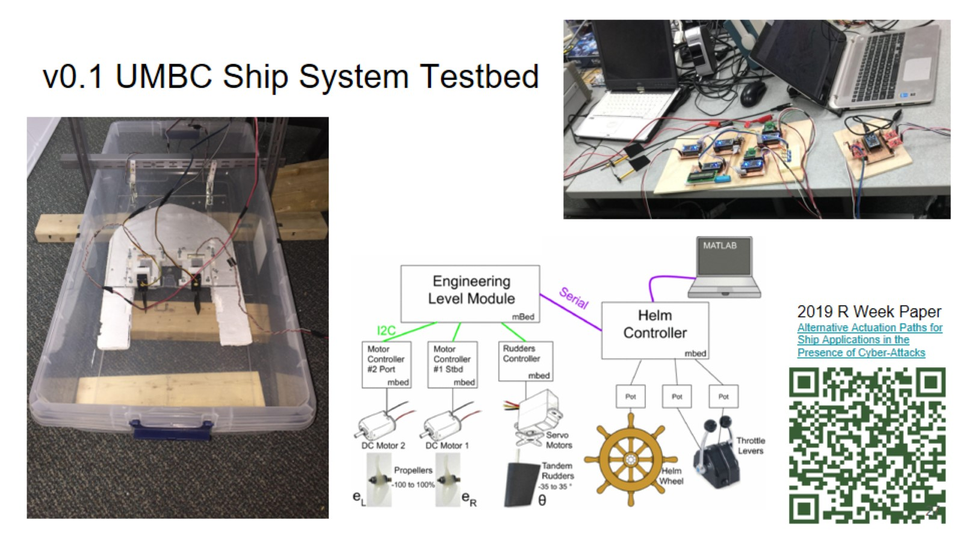
v0.1 UMBC Ship System Testbed

Slide 28
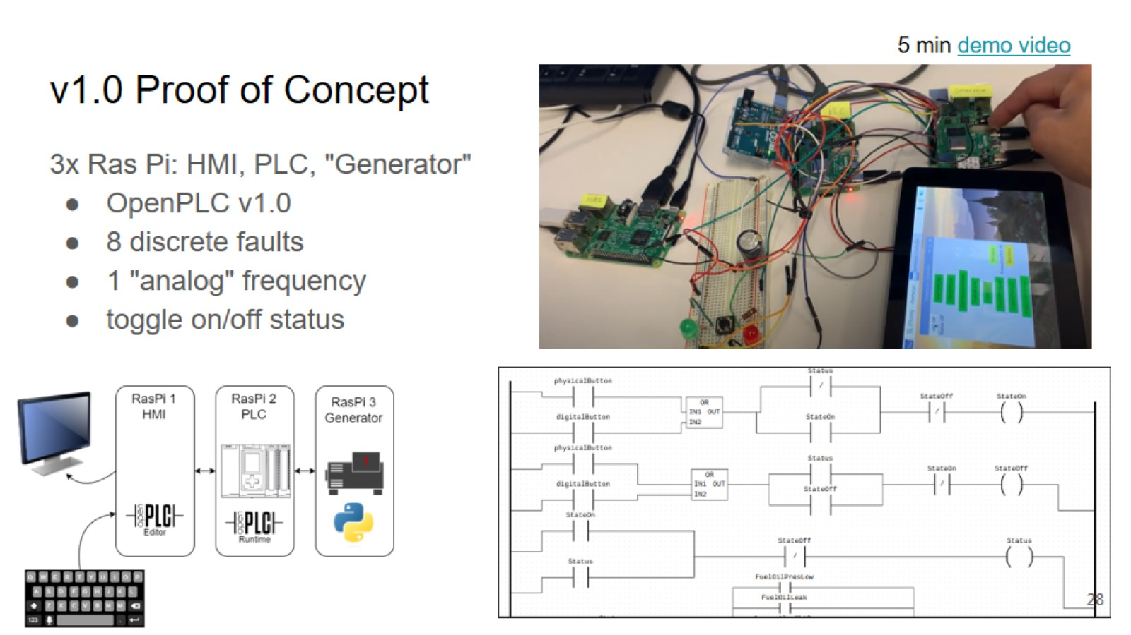
v1.0 Proof of Concept

Slide 29
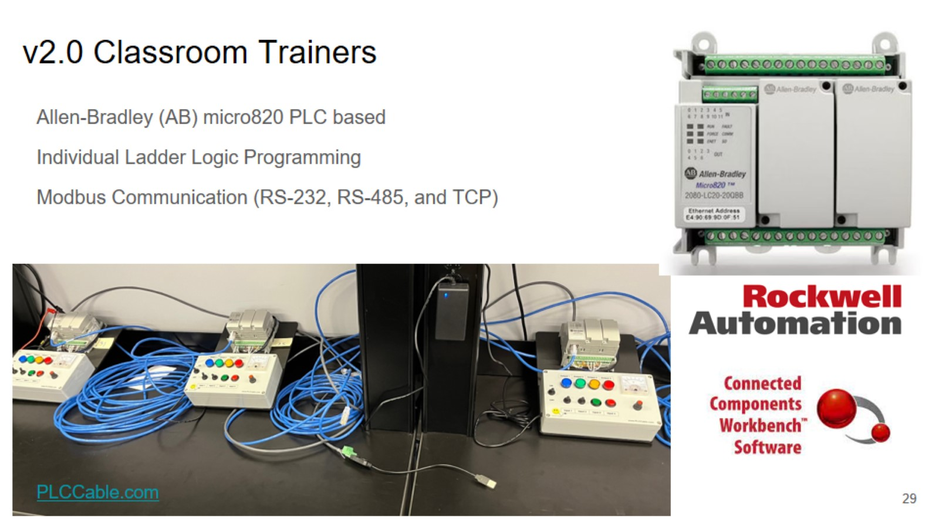
v2.0 Classroom Trainers

Slide 30
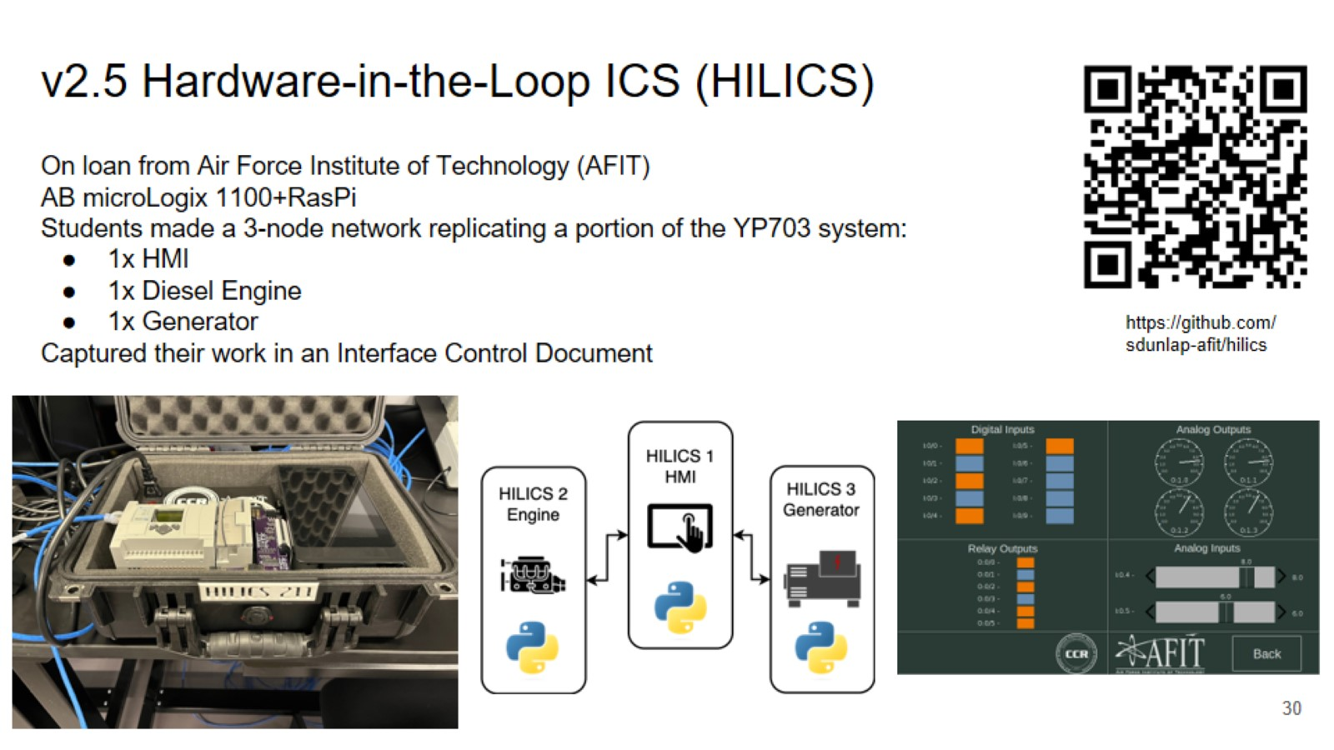
v2.5 Hardware-in-the-Loop ICS (HILICS)

Slide 31
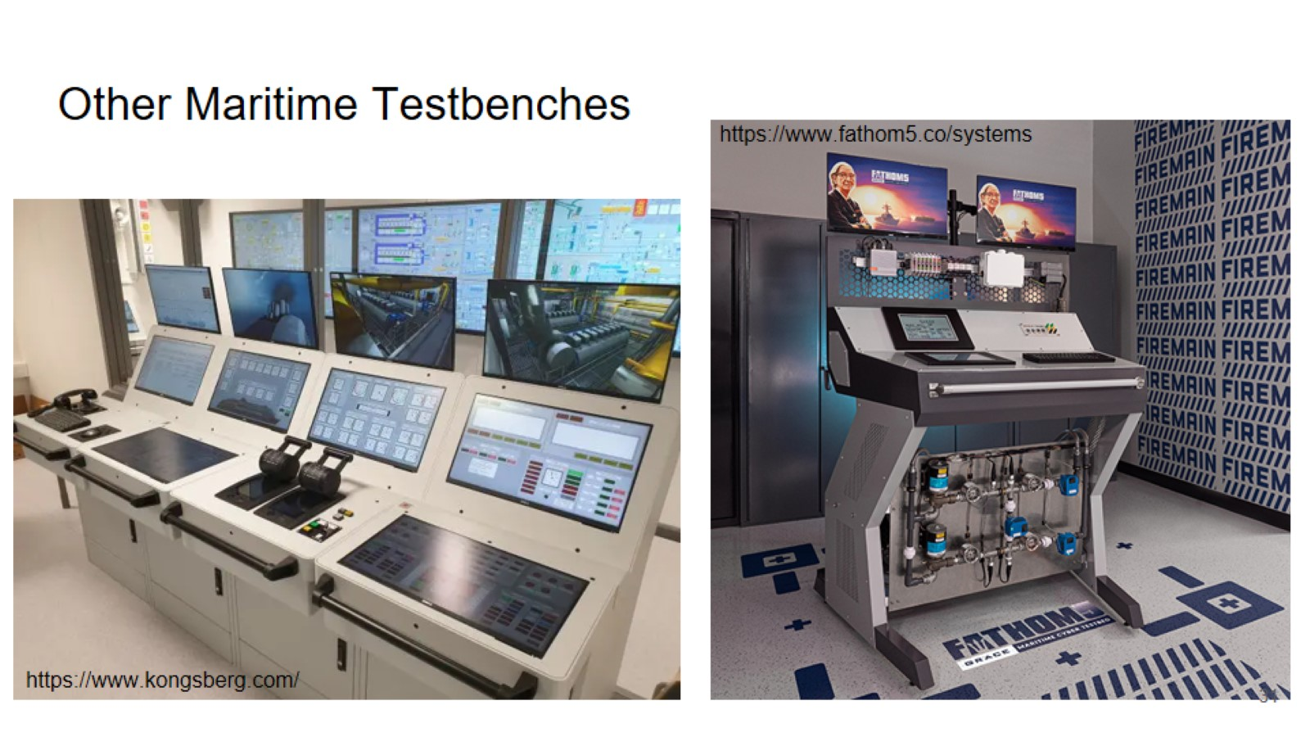
Other Maritime Testbenches

